Slide 1
March 18th
Prion’s disease:
Physiologic role of PrP^{c}
Propagation of PrP^{sc}
Possible treatments for CJD

Slide 2
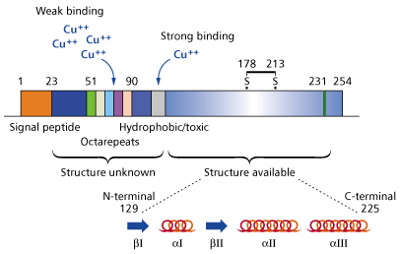
Prion Protein: domains and α-helix structures
www.chemsoc.org
-PrPc contains 208 aminoacid residues and is abundantly expressed in neurons and glial cells
-Signal peptide sequence
-Octarepeats followed by a short Hydrophobic/toxic structure
-The C-terminal portion of the protein is a globular structure that contains 3 α-helix domain and 2 β-helical domains. This domain folds rapidly and is extremely stable

Slide 3
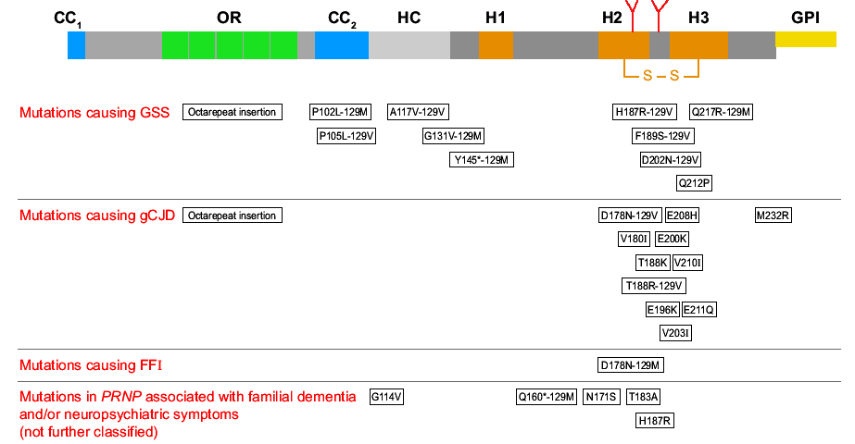
The prion protein: functional domains and mutations causing inherited prion’s diseases

Slide 4
Functional domains of the prion protein
OR: not required for PrPc function, it might influence the change of conformation in PrPsc, as OR KO mice do not propagate the disease. Protects from apoptosis.
CC1: probably involved in protein internalization/trafficking. CC1 KO mice are viable and could develop the disease.
CC2: might work in concert with HC region, as partial deletion of either or the other domain, or ablation of one domain and partial deletion of the other accelerate the pathology in mice.
C-terminal: gene KO on H2, H3 or both domains leads to ataxia and neuron disease, BUT FAIL TO REPLICATE PRIONS.
No transmission of disease from H2 KO and H3 KO to other animals. H2 and H3 might stabilize the conformation of the protein.
C-terminal deletion prevents GPI anchoring of the protein, no development of the disease.

Slide 5
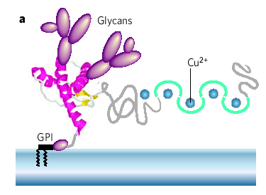
How PrPc anchors to the plasma membrane
Post-translational modifications on Prion protein: Glycosylation and binding to metals
Caughey and Byron, 2006 Nature 443-19

Slide 6
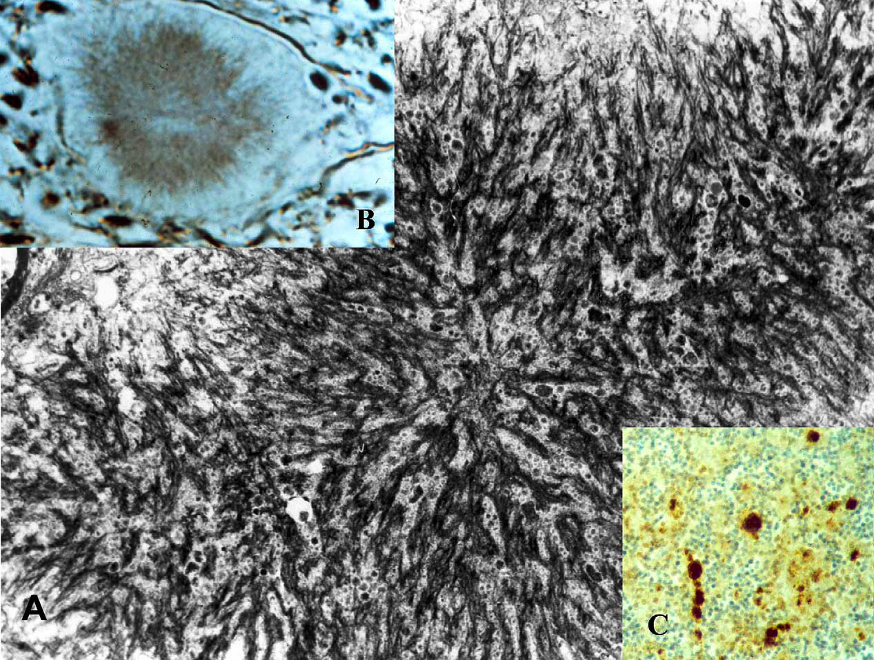
Amyloid plaques in TSE
Kuru disease
GSS disease
Gerstmann-Straussler-Sheinker disease
Kuru disease

Slide 7
http://www.youtube.com/watch?v=10ZIdIRInSc

Slide 8
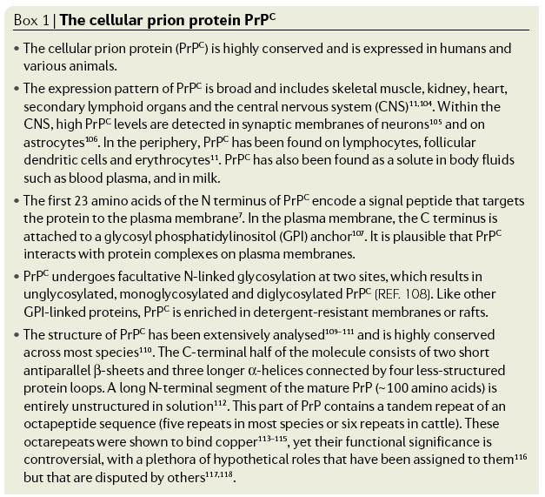
Aguzzi et al., Nat Rev Mol Cell Biol. 2007 Jul;8(7):552-61

Slide 9
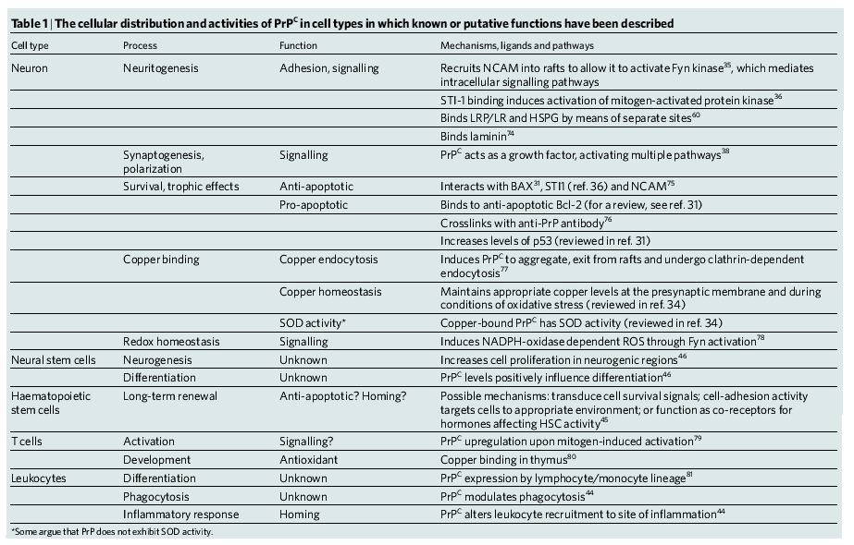
Physiologic role of PrP^{c}
Caughey and Byron, 2006 Nature 443-19

Slide 10
Antiapoptotic function:
PrP^{c} KO mice are more susceptible to apoptosis.
Following ischemic injury, PrP^{c} KO mice have increased infarct volume and increased caspase 3 activation.

Slide 11
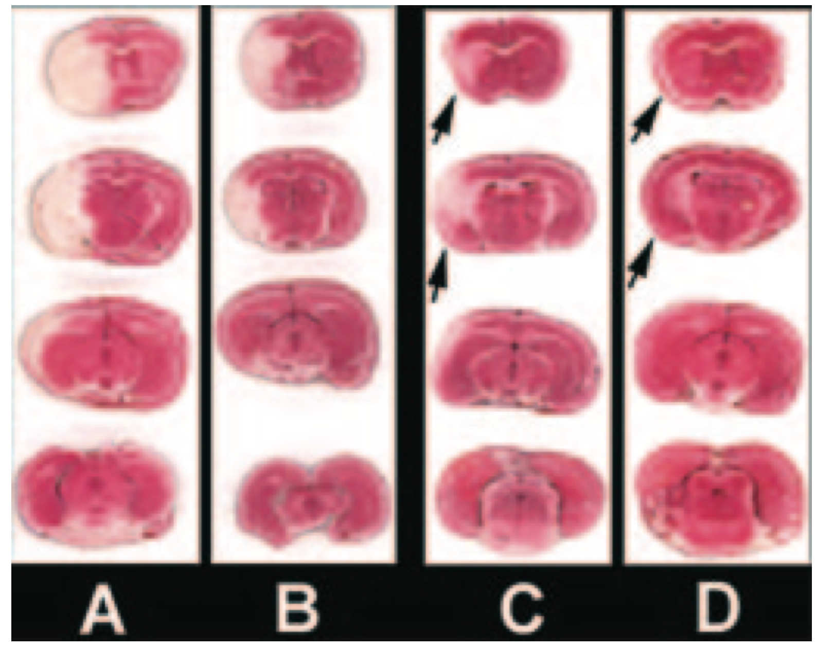
Infarcts are larger in PrP^{c} KO mice after ischemic injury
KO
WT
KO
WT
Permanent
Transient

Slide 12
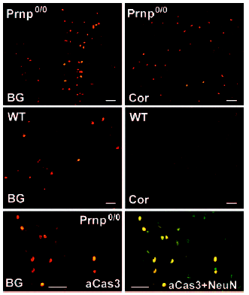
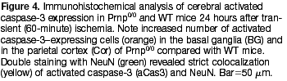
Levels of activated caspase 3 are increased in PrPc KO mice after ischemic injury

Slide 13
PrP^{c} protects against oxidative stress
PrP^{c} Ko mice are more susceptible to damage by H₂O₂
PrP^{c} KO mice have reduced SOD activity
Brain of PrP^{c} KO mice has increased levels of oxidized proteins, lipids, DNA.
PrP^{c} also involved in maintaining mitochondrial integrity

Slide 14
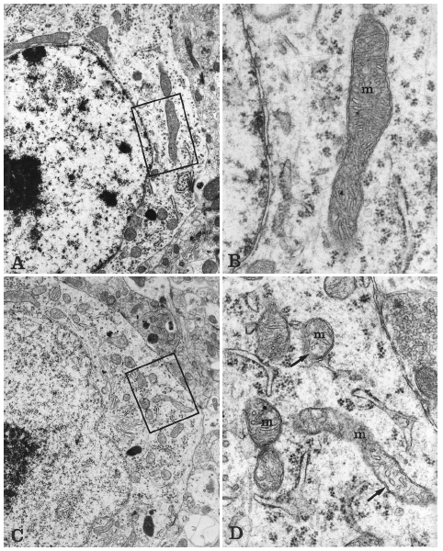
Mitochondrial structure is disrupted in Prion’s infected hamsters
Control
Prion’s infected

Slide 15
PrP^{c} maintains synaptic architecture and function
PrP^{c} localizes mainly at the synaptic terminal
PrP^{c} KO mice have impaired Glutamatergic and GABAergic transmission, as well as decreased LTP.
Synaptic loss is an early pathologic change in prion’s disease.

Slide 16
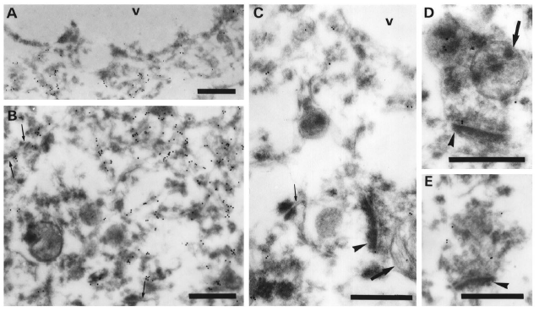
PrP stains as a flocculate/amorphous form at a synaptic level
Thin arrows: synaptic contacts
Arrowheads: Post-synaptic densities
Arrow: pre-synaptic mitochondria

Slide 17
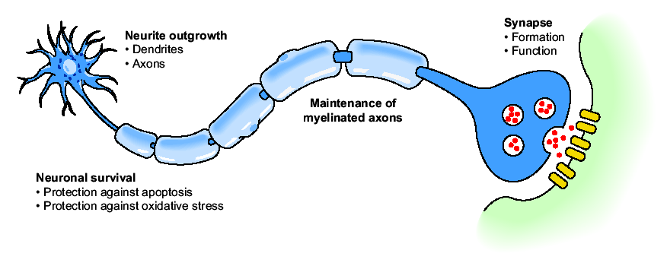
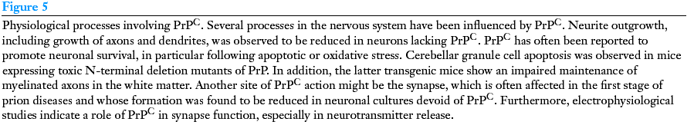
PrP^{c} physiological functions

Slide 18
How does the prion form?
How does it propagate?

Slide 19
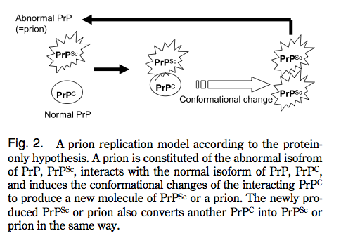
Mechanism of replication of PrP^{Sc} from PrP^{C}
Sakaguchi

Slide 20
Nature of the prion
The prion is the minimum required infectious agent able to convert normal cellular prion protein Prp^{C} into the scrapie PrP^{sc}.
Is the prion a virus?
NO, the prion is not a virus, as RNA and DNA material are totally absent in its composition, and the minimal molecular weight necessary for infectivity is ~2x10⁵Da, so small to exclude the size of a virus.
Is the prion proteinaceous material?
YES

Slide 21
The “unfortunate” goal of CDJ disease is to convert normal cellular prion protein PrP^{C} into the scrapie form PrP^{sc}.
This will result in
1-reduction of the form with α-sheet conformation
2-accumulation of the form with β-sheet conformation, which will form aggregates and deposit both at an intracellular and extracellular level.

Slide 22
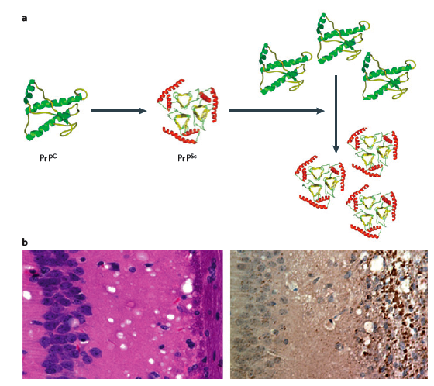
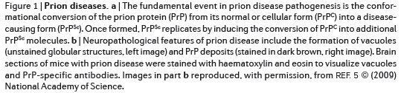
Models for conformational conversion of PrP^{c} into PrP^{sc}

Slide 23
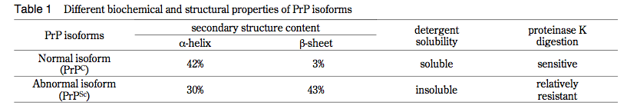
Different biochemical and structural properties
between PrP^{C} and PrP^{Sc}
Sakaguchi

Slide 24
The “protein-only” hypothesis
-In vitro data suggest that prion infectivity is achieved also de novo in the test tube.
-Propagation of conformationally changed yeast prions has been achieved.
-In vivo, prion protein null mice (PrP^{-/-} or PrP KO) are resistant to prion infection, do not propagate prion infectivity after exposure to PrP^{Sc}, suggesting that PrP^{C} is necessary to propagate the infectivity caused by PrP^{Sc}.
Prion protein null mice do not propagate prion infection also when infected with infectious brain tissue. This implies that the protein PrP^{C} ALONE (and not in combination with other cellular or putative viral factors) is sufficient to propagate the prion infectivity.
-Brain homogenates spiked with PrP^{Sc} and subjected to sonication and recovery amplify the infectious species which maintains infectivity when “transferred” to new tissue.

Slide 25
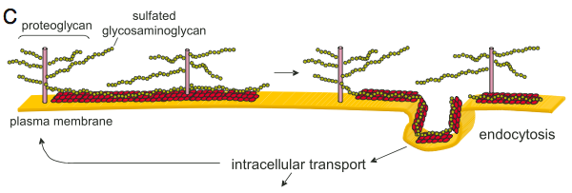
Other molecules involved in replication of prions?

Slide 26
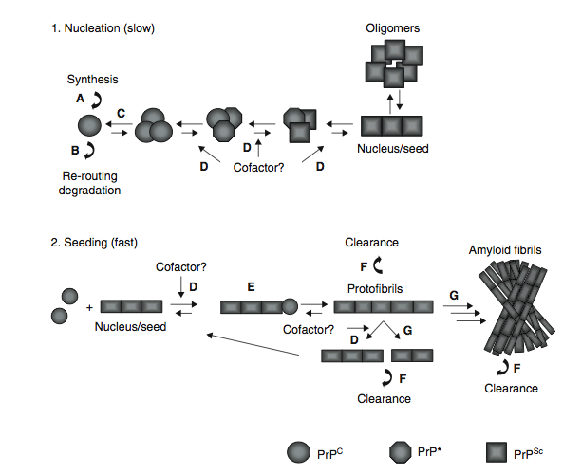
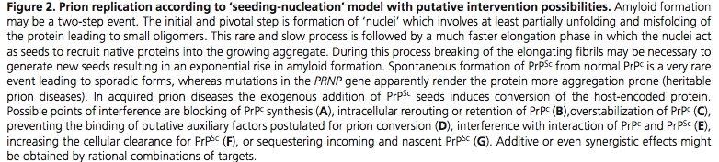
The “seeding:nucleation” model in Prion’s replication

Slide 27
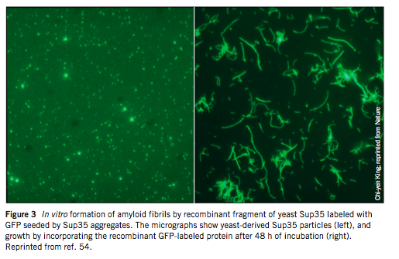
Fibrils of prion protein: self propagating mechanism?
Prion Particles
Prion Particles+yeast protein
Prion Profile: Far left, infectious prion particles extracted from yeast cells. At right is an example of what yeast prions can do when mixed with an isolated yeast protein. These fibrils are essentially long series of prions all linked together after replicating many times in the presence of the protein.
Soto and Castilla
Nat Med. 2004 Jul;10 Suppl:S63-7. Review.

Slide 28
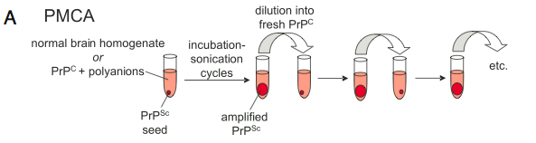
PMCA Protein Misfolding Cyclic Amplification

Slide 29
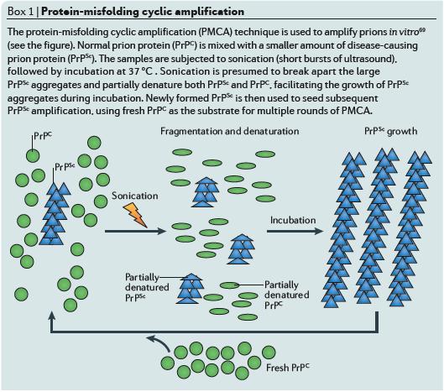
PMCA: protein misfolding cyclic amplification:
a technique to amplify prions in vitro

Slide 30
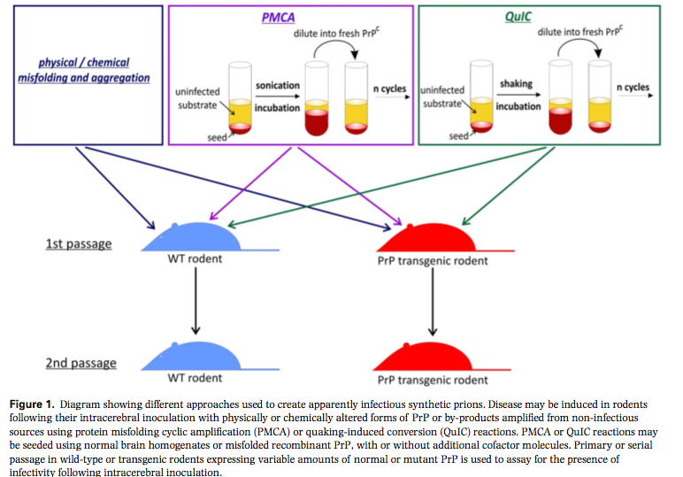
PMCA to generate synthetic strains of prions
QuiC: reproducibility of shaking vs sonicating in PMCA

Slide 31
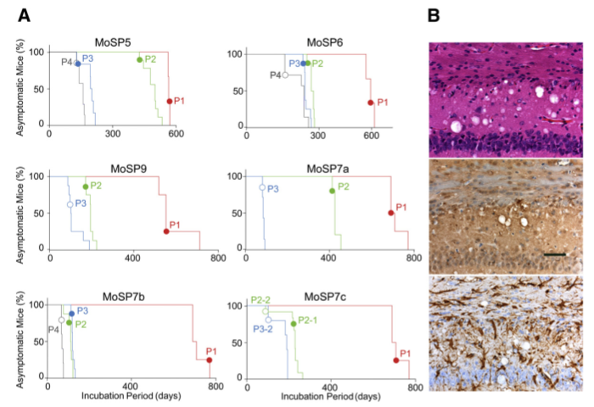
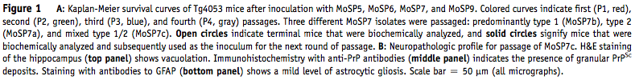
Inoculation of synthetic strains of prions to generate animal models for prion’s disease
Vacuolization in Hip
Granular deposits of PrP^{sc}
Astrogliosis

Slide 32
PrP^{c} localizes at the plasma membrane and undergoes internalization

Slide 33
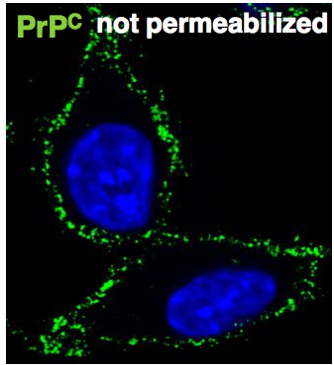
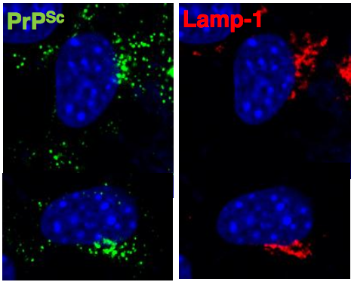
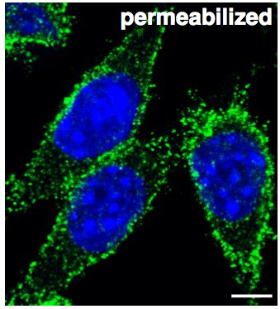
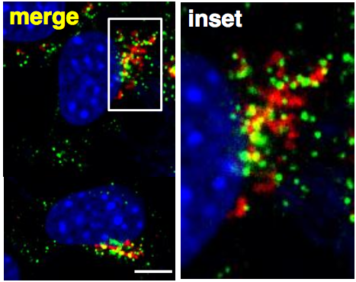
Upon infection, PrP relocalizes from the plasma membrane to endocytic compartments

Slide 34
Where does the conversion from PrP^{c} to PrP^{sc} occur?
Transport of PrP^{sc}?

Slide 35
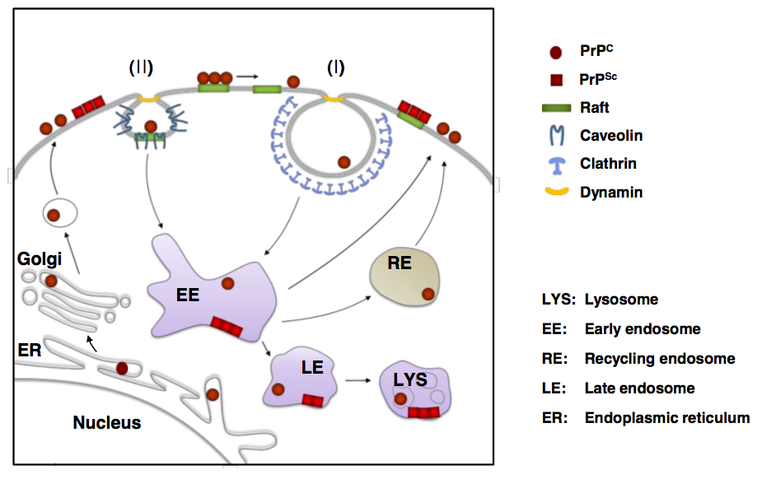
Cell biology of PrP in scrapie infected cells

Slide 36
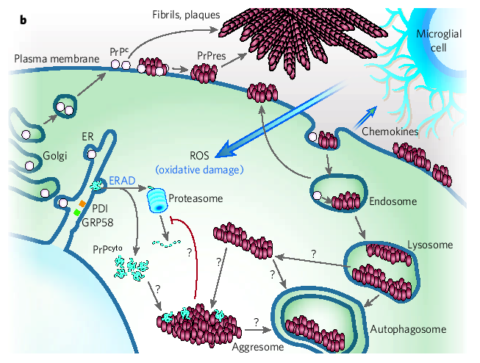
Prion protein scrapie accumulation and propagation
from normal cellular Prion protein (PrP^{C} to PrP^{sc})
Caughey and Byron, 2006 Nature 443-19

Slide 37
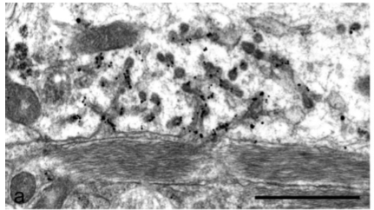
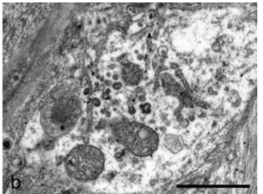
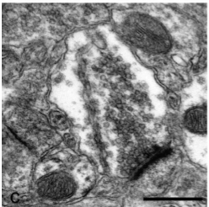
Membrane modifications are associated with PrP propagation
Dendrite of natural sheep scrapie brain
Dendrites of a clinical diseased intracerebrally inoculated with a synthetic PrP source.
Axon terminal from a 22CH scrapie-infected hamster

Slide 38
GPI anchor as a target for the treatment of CJD?

Slide 39
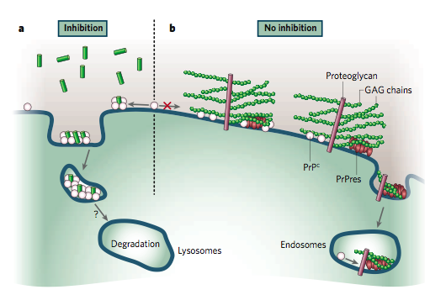
Inhibition of GPI-anchor could reduce the amount of PrP^{C} at the plasma membrane, reducing propagation of the prion
Caughey and Byron, 2006 Nature 443-19

Slide 40
Can cytosolic aggregates seed for propagation?

Slide 41
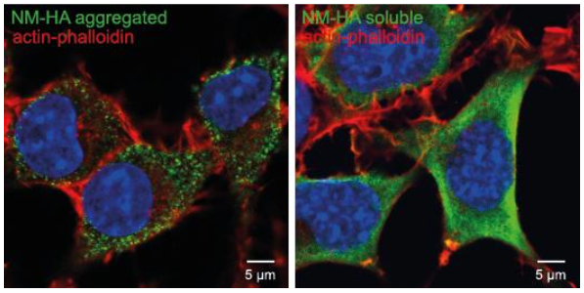
PrP aggregates can be found at an intracellular level
Fibrils

Slide 42
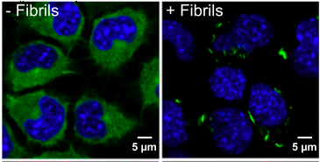
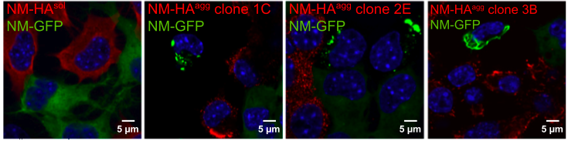
Cytosolic PrP^{C} can form intracellular aggregates in presence of extracellular PrP fibrils

Slide 43
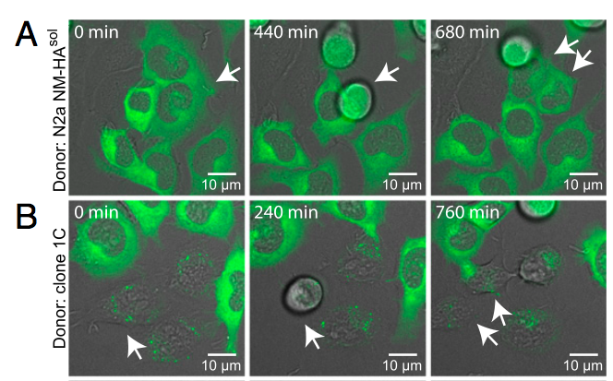
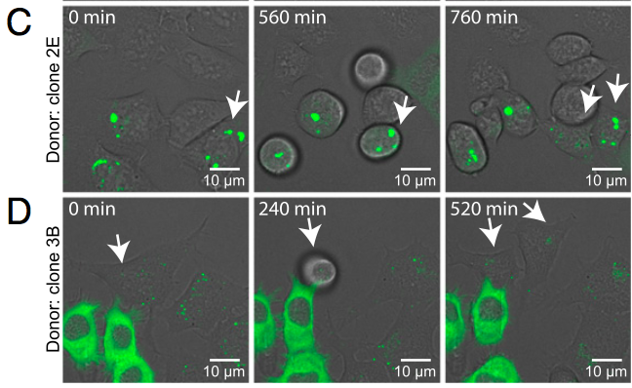
Induced intracellular aggregates can be transmitted to progeny

Slide 44
PrP^{sc} is toxic both when extracellular and intracellular
MECHANISM?
Loss of physiologic function or gain of toxic function?

Slide 45
PrP^{c} KO mice are viable, develop normally and have no severe pathologies observed later in life.
PrP^{c} KO do not develop the disease as they do not propagate the formation of PrP^{sc}
Gain of toxic function rather than loss of physiological function

Slide 46
Approaches for the treatment of CJD
Use of molecules that associate with PrP^{C} and interfere with the capacity of PrP^{Sc} to bind and to propagate the infectious principle.
-GPI inhibitors
-PrP^{Sc} antibodies: problems in achieving the right level of immunization
(prion protein is a self antigen, and immunesystem is involved in the replication of the prion agent and its ultimate access to the CNS).
Active immunization with recombinant protein has relatively modest therapeutic effects in mice.
Passive immunization effective within a month after exposure to the contaminant. However, too expensive and not effective if performed in advanced stages of the disease, when the animal is symptomatic.

Slide 47
-Use of autophagy-inducing molecules
Autophagy can target the degradation of PrP^{sc} aggregates

Slide 48
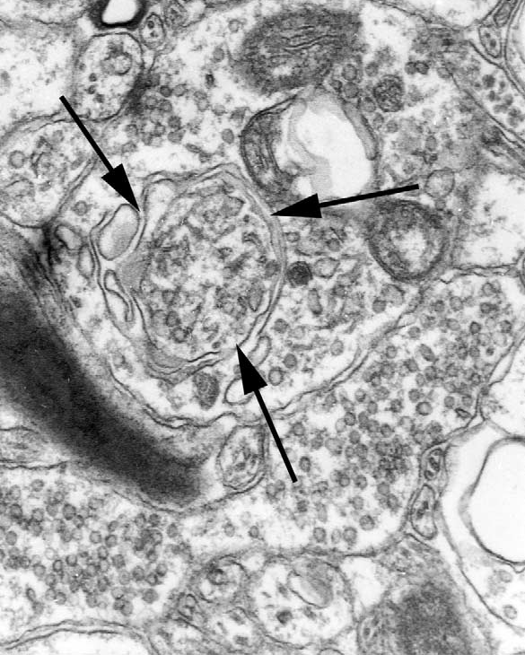
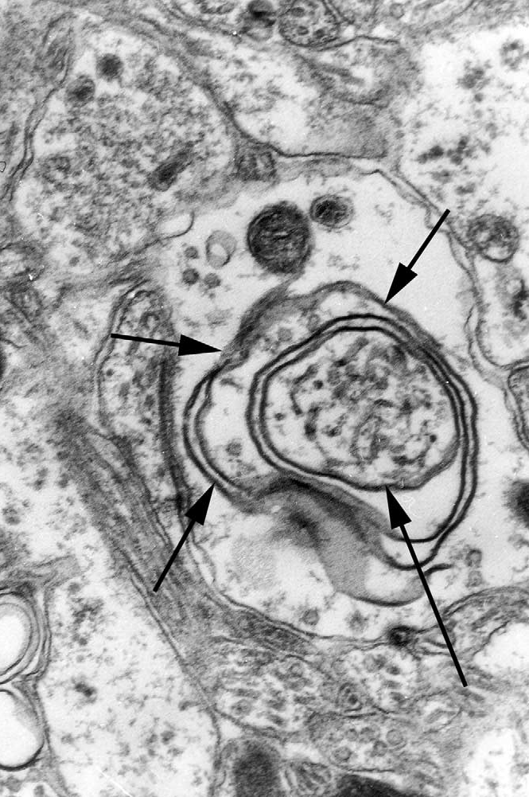
Autophagic vacuoles form at the synapse of human vCJD brain

Slide 49
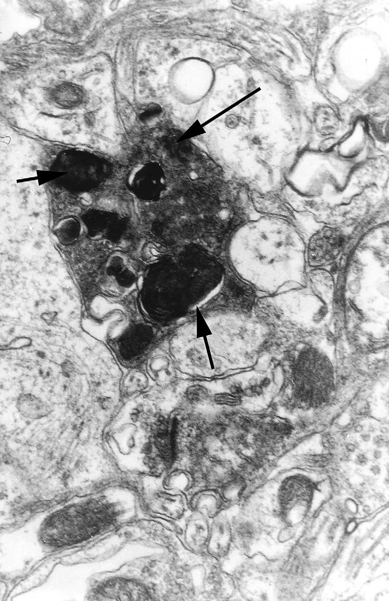
Accumulation of degenerating lysosomes and other organelles
at the dark synapse in human vCJD brain

Slide 50
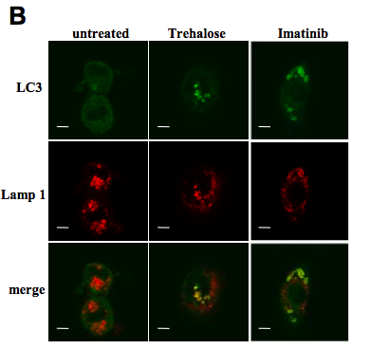
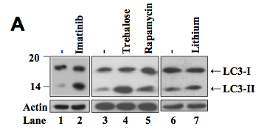
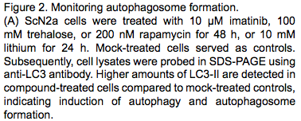
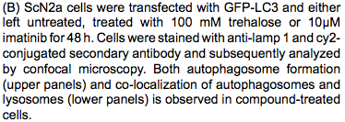
Autophagy-inducing drugs can regulate
autophagy in scrapie infected cells

Slide 51
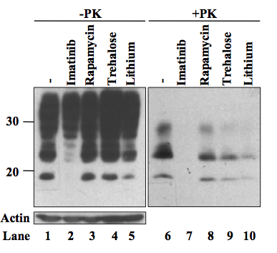
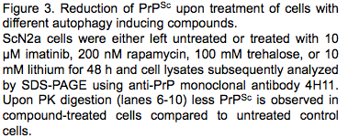
Autophagy-inducing drugs can reduce the PK resistant load of PrP^{sc} aggregates

Slide 52
Autophagy-inducing molecules as a valid approach?

